Slide 1
BITS Pilani presentation
K.Anantharaman
Faculty CS Department
kanantharaman@wilp.bits-pilani.ac.in
13-Jan-24
Agile SW Processes SE ZG544 S2-23-24

Slide 2
SE ZG544 S2-23-24
Agile Software Processes
Lecture No. 1, Module 1 - Agile Methods - An Introduction
13-Jan-24
Agile SW Processes SE ZG544 S2-23-24

Slide 3
Introduction
Faculty introduction
Email Id : kanantharaman@wilp.bits-pilani.ac.in
e-learn portal: https://elearn.bits-pilani.ac.in/
Course Handout
Recorded Video Lectures in e-learn/Taxila portal
According to the course handout, grouped by module
You MUST go through each module before coming to the online session
13-Jan-24
Agile SW Processes SE ZG544 S2-23-24

Slide 5
Student Expectations Poll
Objective:
Online poll to understand the expectations of students attending this course.
Link
13-Jan-24
Agile Software Processes SE ZG544 S2-23-24

Slide 6
Module 1 – Topics
Traditional software development practices
Need for Agile Methods
Benefits of Agile Methods
13-Jan-24
Agile Software Processes SE ZG544 S2-23-24

Slide 7
Module 1: Key points covered in the recorded presentation
Traditional software development had high failure rates (Standish Group Chaos report 2015)
Agile emerged as an iterative approach with continuous testing and feedback
Benefits: Faster time-to-market, reduced risk, adapt to change
Short sprints prioritize working software
Focus on business value and managing evolving requirements
Stakeholder collaboration through demos and feedback
Continuous inspection and adaptation
Key aspects: short sprints, close teamwork, continuous integration and testing, customer feedback
13-Jan-24
Agile Software Processes SE ZG544 S2-23-24

Slide 8
Q&A
This Q&A is based on Module 1 of the recorded presentation.
Q&A Link- 3 Sections

Slide 9
Project Management Model
Waterfall and Agile Models
Agile SW Processes SE ZG544 S2-23-24
13-Jan-24
Agile SW Processes SE ZG544 S2-23-24

Slide 10
Basic Project Management concepts
What is a Project?
Definite Start-End date, Temporary, Scope(Produce Specific result) , Budget/Effort – Example: Building a house, Word Processor V.0
Project Management Life Cycle Phases
Initiation, Planning, Execution, Monitoring & Control. Closeout
System Development Life Cycle/phases (SDLC)
Requirements, Design, Construction, Testing, Implementation/deployment/Release
Ref. doc uploaded in Teams: Introduction to Software Development
13-Jan-24
Agile SW Processes SE ZG544 S2-23-24

Slide 11
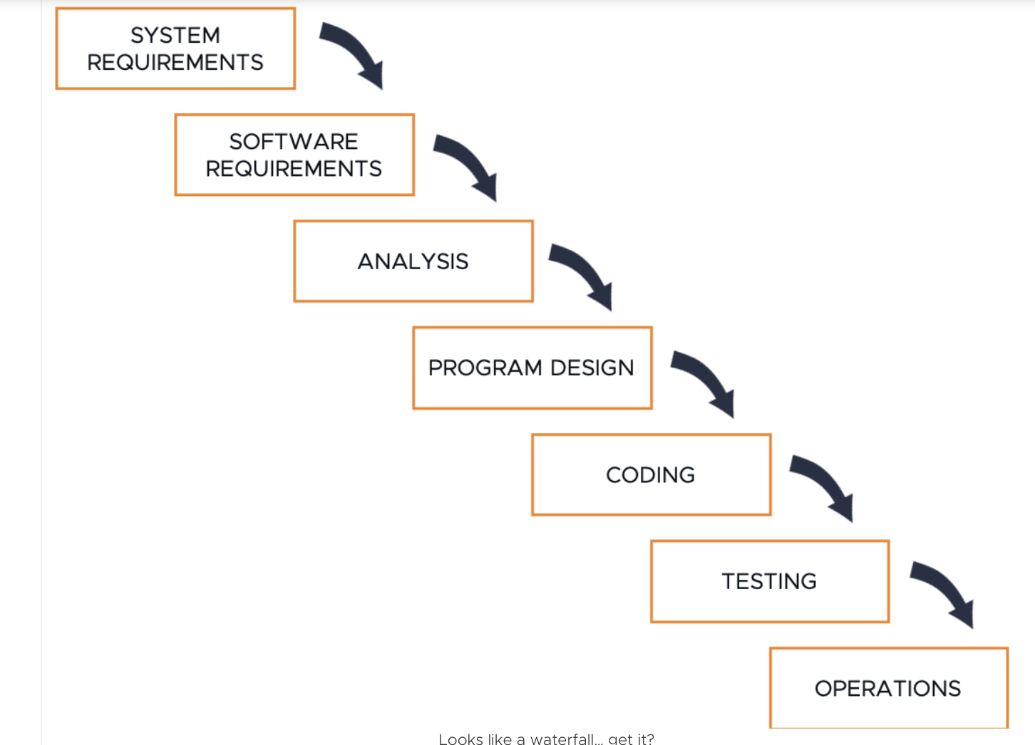

Waterfall Approach to Software Development
Waterfall/Predictive/Traditional
( Different terminologies that refer to same approach)
Phases & Phase Gate
Move to the next phase only when the prior one is complete — hence, the name waterfall.
Origin from manufacturing like production plant
Upfront Planning
Detailed documentation
Scope of work is generally fixed.
Output of a phase becomes input to next phase
Include well defined checklists, process and tools
Customer Release-Value realization
https://www.beyond20.com/blog/when-to-use-agile-and-when-to-use-waterfall-when-managing-projects/
13-Jan-24
Agile Software Processes SE SG544 S2-23-24

Slide 12
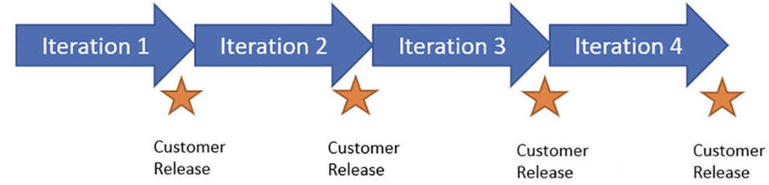
Agile Approach to Software Development
Agile/Adaptive/Iterative & Incremental
( Different terminologies that refer to same approach)
Sprints & Sprint Review
Design, Coding and Testing in each iteration in any order
Origin from lean manufacturing
Rolling Wave Planning
Less documentation
Negotiable feature sets
Minimum process and tools
Customer Release-Value realization in each iteration
13-Jan-24
Agile SW Processes SE ZG544 S2-23-24

Slide 13
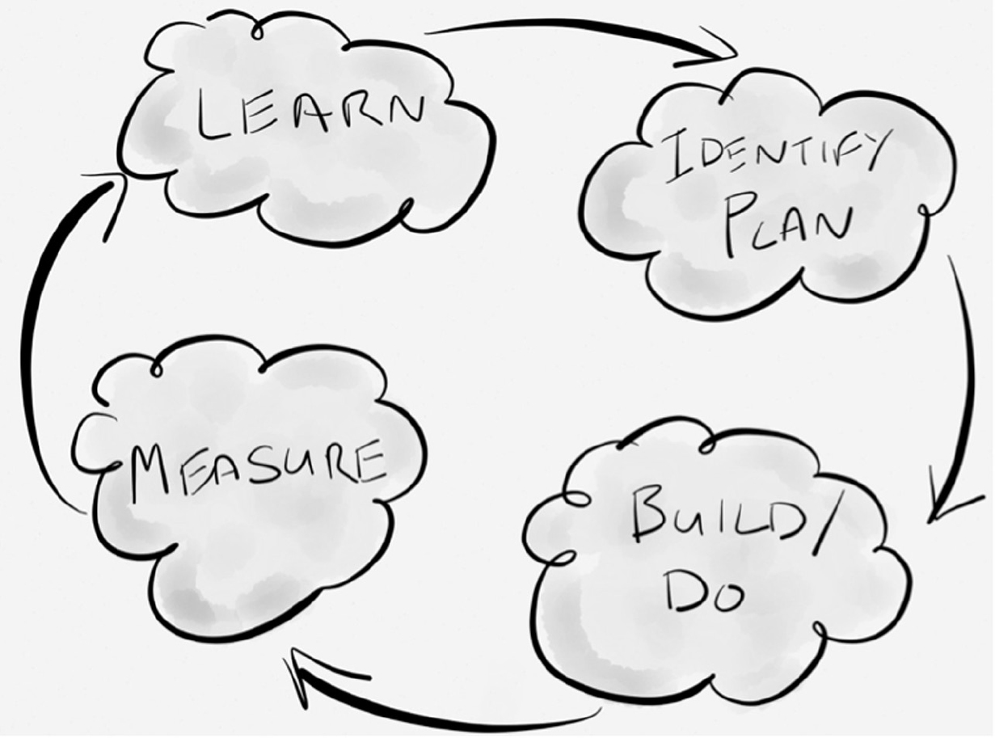
Agile is based on Empirical Process Control
Inspection
inspect the product being created and how it is being created
Adaption
adapt the product being created or the creation process if required
Transparency
ensure everyone can easily see what is happening
PDCA Cycle
13-Jan-24
Agile Software Processes SE ZG544 S2-23-24

Slide 14
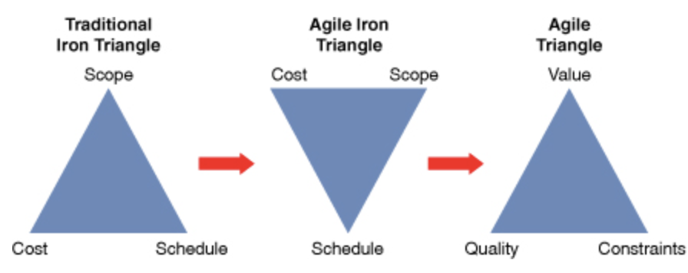
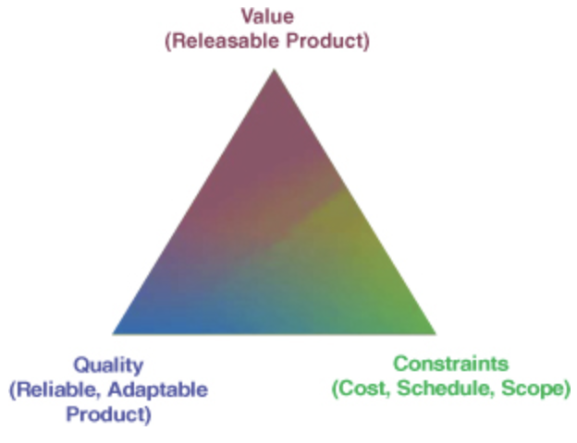
Iron Triangle of Project management The Evolution to an Agile Triangle
Fixed
Variable
Fixed
Variable
Fixed
Fixed
Variable
(Scope, Time,Cost)
Reference: Agile Project Management: Creating Innovative Products, Second Edition, Jim Highsmith, Published by Addison-Wesley Professional
13-Jan-24
Agile Software Processes SE ZG544 S2-23-24

Slide 15
Q&A?
Link – 5 Sections
13-Jan-24
Agile Software Processes SE ZG544 S2-23-24

Slide 16
Advantages and Disadvantages of Waterfall & Agile
Waterfall
Advantages
Sequential, Upfront planning
Good Documentation
Scope of work is generally fixed
Disadvantages:
Error propagation
Missing requirements
Error correction is costly
Late customer feedback
Agile
Advantages:
Early delivery of business value
Continuous improvement
Scope flexibility
Team input
Delivering well-tested products
Disadvantages:
Poor Resource planning
Less Documentation
Fragmented output
13-Jan-24
Agile SW Processes SE ZG544 S2-23-24

Slide 17
Application of Waterfall and Agile Model
Waterfall
Most common Project Management approach
Surpassed by Agile approach after 2008.
Simple and small systems.
Enchantments to software systems
Mission critical systems.
Agile
Fast Changing deliverables - New Technology Emerging projects
Projects without clear requirements in the beginning.
New Product Development Projects
Early Visibility, Quality, Risk identification
13-Jan-24
Agile Software Processes SE ZG544 S2-23-24

Slide 18
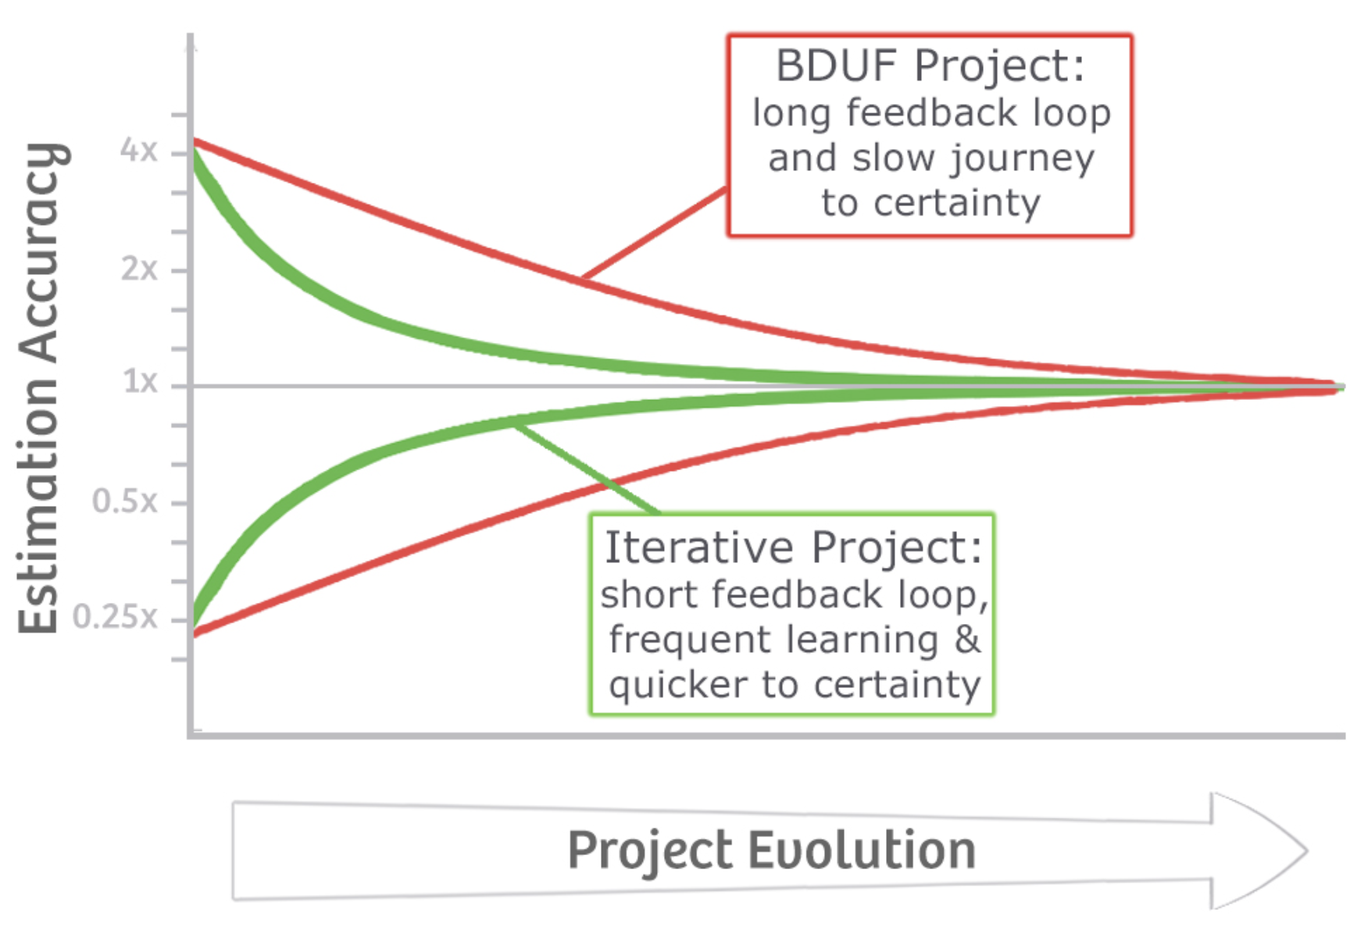
Cone of Uncertainty
BDUF- Big Design Up Front
Waterfall Approach
Emergent Design
Agile Approach
Reference/: https://agilecoffee.com/wp-content/uploads/2016/12/07-cone-of-uncertainty.jpg
13-Jan-24
Agile Software Processes SE ZG544 S2-23-24

Slide 19
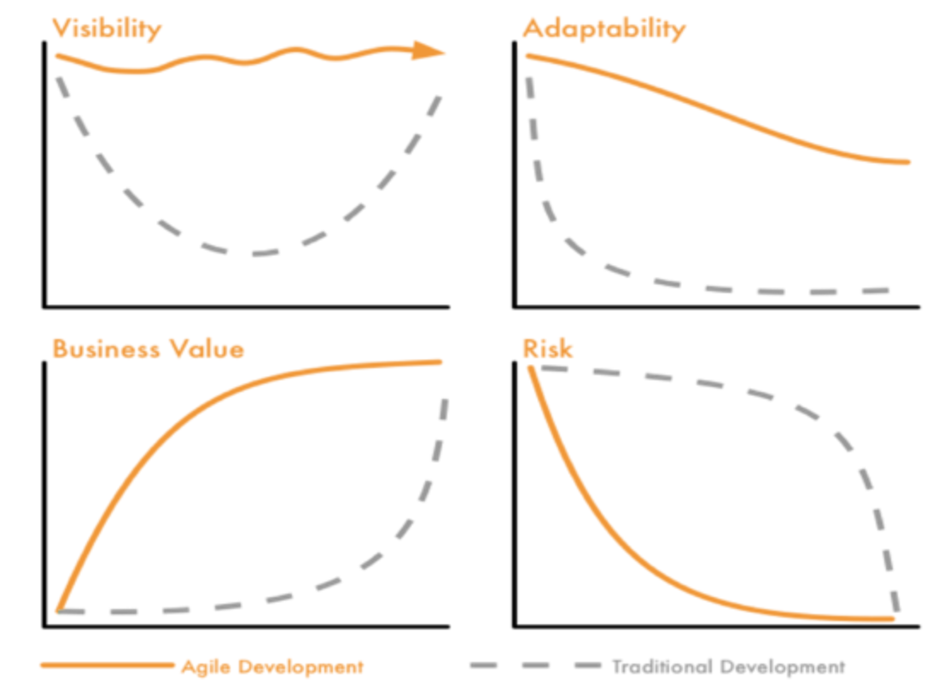
Other benefits of agile approach
Reference: https://www.beyond20.com/blog/when-to-use-agile-and-when-to-use-waterfall-when-managing-projects
13-Jan-24
Agile Software Processes SE ZG544 S2-23-24

Slide 20
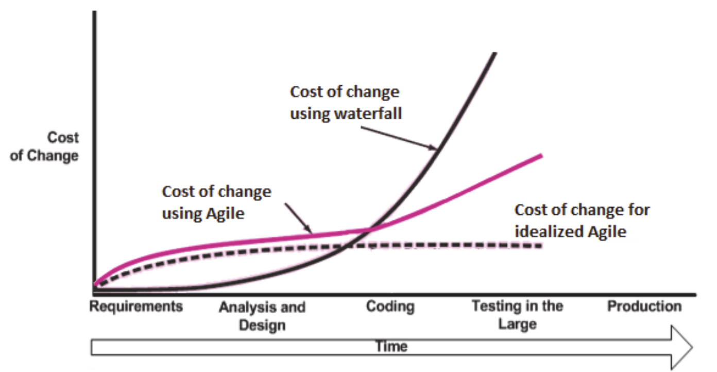
Cost of change
https://www.researchgate.net/figure/Cost-change-curve-of-traditional-and-agile-methodology-23_fig9_312564218
13-Jan-24
Agile Software Processes SE ZG544 S2-23-24

Slide 21
Need for Agile Methods
13-Jan-24
Agile Software Processes SE ZG544 S2-23-24

Slide 22
Software Project Success and Failure
In 2006, Standish Group did a study of 10,000 projects in USA.
The results showed that:
29% of traditional/Waterfall projects failed outright
60 percent of traditional projects exceeded the budget
11 percent of projects succeeded.
Hence, The way we manage projects needs to change.
Agile was established in early 2000.
13-Jan-24
Agile Software Processes SE SG544 S2-23-24

Slide 23
Benefits of Agile Methods
13-Jan-24
Agile Software Processes SE ZG544 S2-23-24

Slide 24
Corporate World - Challenges and Inefficiencies
Missed (or rushed) deadlines.
Budget blow-outs
Overworked and stressed employees.
Knowledge silos.
Technology innovations and Agile approaches that have enabled to overcome these challenges (IT and Manufacturing industries)
13-Jan-24
Agile Software Processes SE ZG544 S2-23-24

Slide 25
Benefits of Agile Methods/Approaches/Practices/Techniques
Responsive planning
Business-value-driven work
Hands-on business outputs
Direct stakeholder engagement
Immovable deadlines
Management by self-motivation
Just-in-time’ communication
Immediate status tracking
Waste management
Constantly measurable quality
Continuous improvement
Flexibility (Rigid Vs Adaptive)
Ownership & Transparency (Project Manager vs Team ownership)
Problem Solving (Unexpected obstacles-Escalation vs Team take decision)
Checkpoints and Monitoring progress: (No Frequent check-ins vs Quicker Iteration delivering value)
13-Jan-24
Agile Software Processes SE ZG544 S2-23-24

Slide 26
Thank You
13-Jan-24
Agile Software Processes SE SG544 S2-23-24

